Slide 1

UE19CS204 – Web Technologies Mini Project
Project Title – Simple Electronics E-commerce Site
Section - G
Sreenath Saikumar – PES2UG19CS406
Suravarjhula Sasira – PES2UG19CS415
Vanga Nithya Reddy – PES2UG19CS446
GITHUB Link - https://github.com/SreenathSaikumar/wtproject

Slide 2
Abstract
The aim of this project is to create a simple, working demonstration of a basic E-commerce website, UI design and CRUD operations using a MERN( MongoDB, ExpressJS, ReactJS, NodeJS) stack.
This project also helps further improve understanding of the various technologies used in the making of a website.
The website allows users to view a collection of products, add them to the cart and simulate a ‘checkout’ to confirm the purchase. They can also view the orders they made.

Slide 3
Technologies Used
ReactJS- ReactJS is used to create the frontend of the website alongside React-Router which handles routing to the different pages in the website. React Context is also used as a method to send data across different pages.
Axios- Axios is used to send HTTP requests to the backend server along with a request body to fetch the relevant information such as getting product info, handling user logins/register information as well as updating the database with new information as the user checks out with items in the cart.
JWT Server Auth- It is a prebuilt JSON server module that is used primarily to handle all user info. It creates a login endpoint that accepts a username & password and generates and sends back a JSON Web Token which is decoded by jwt-decode to successfully login a user. It’s register endpoint also takes a username and password, encrypts the password using bcryptjs and stores it in a .json file for easy access.
JWT-Decode- This module is used to decode and parse the information contained in the JSON Web Token that is sent from the JSON Server that handles user information.
ExpressJS- Express app is used to set up the backend API that handles requests made by the frontend and GETs/ modifies the product database. It works in conjunction with mongoose and accepts GET, PUT and POST requests to make changes and get info from the product database.
CORS- Used to handle cross-server requests.
Body-Parser- It is used to parse the body of any incoming request before it is handled by Express.
Mongoose- Mongoose is used to fetch, create, update the database responsible for storing all the product information. It uses different Schema to search for and display specific documents from a collection from a MongoDB Server instance.
Bulma- A premade CSS file/module that is used to handle all the styling done for the frontend.

Slide 4
Member Contributions
Sreenath:
Designing the front-end using ReactJS and making API calls using Axios.
Handling user login/registration functionalities using Axios and JSON-server-auth.
Creating and handling database calls through Mongoose, ExpressJS and Body-parser.
Cart functionality.
Order view functionality.
Sasira:
Handling page routing using React Router.
Creating the register form.
Nithya:
Creating the database for the products.
Creating the login form.

Slide 5
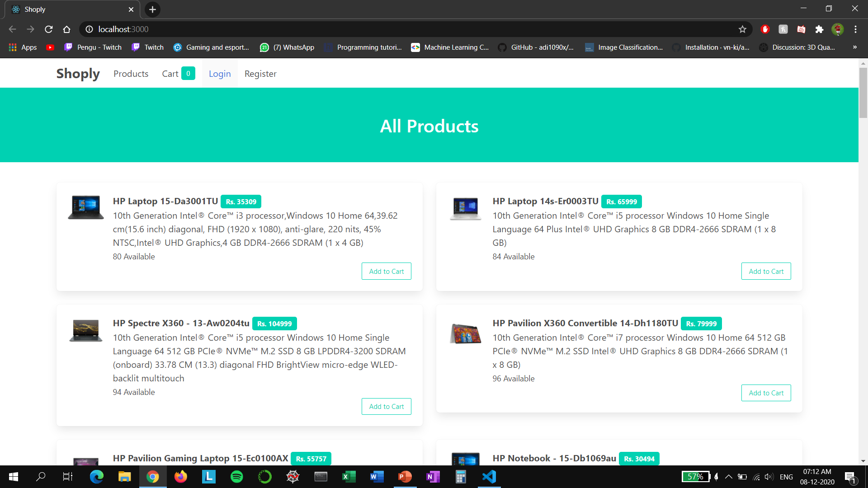
Screenshots

Slide 6
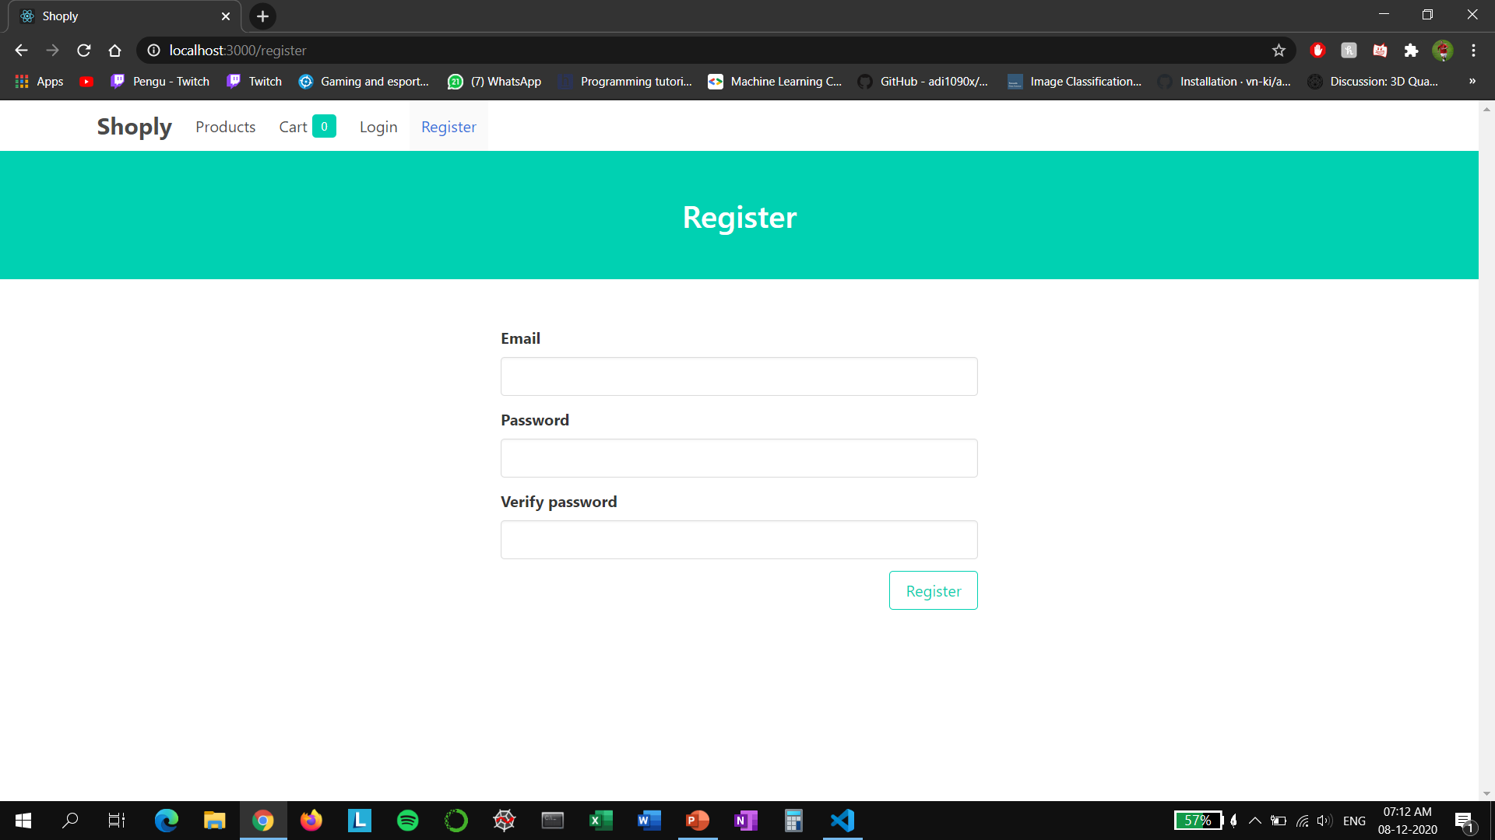
Screenshots

Slide 7
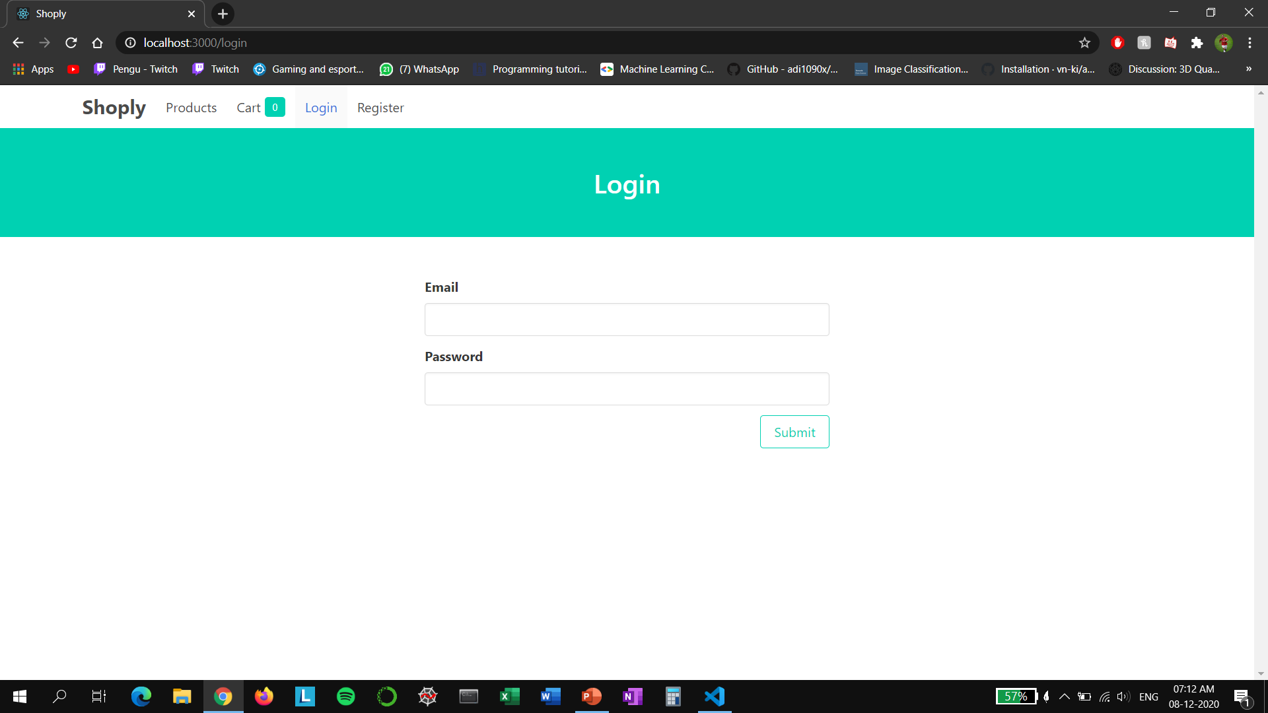
Screenshots

Slide 8
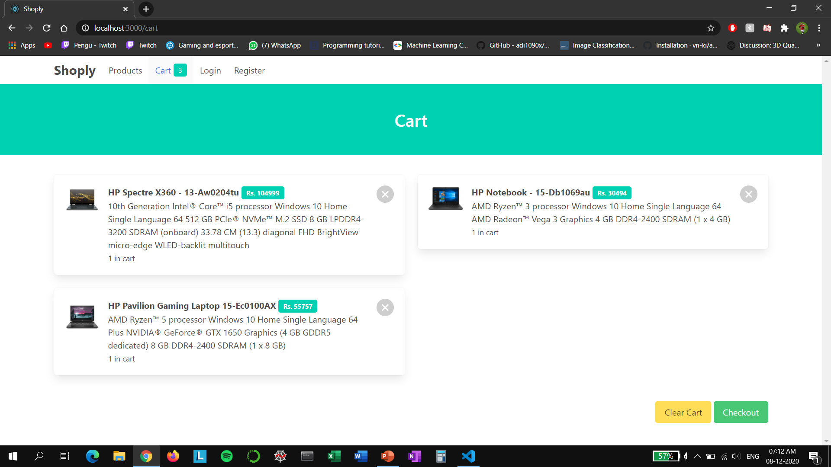
Screenshots

Slide 9
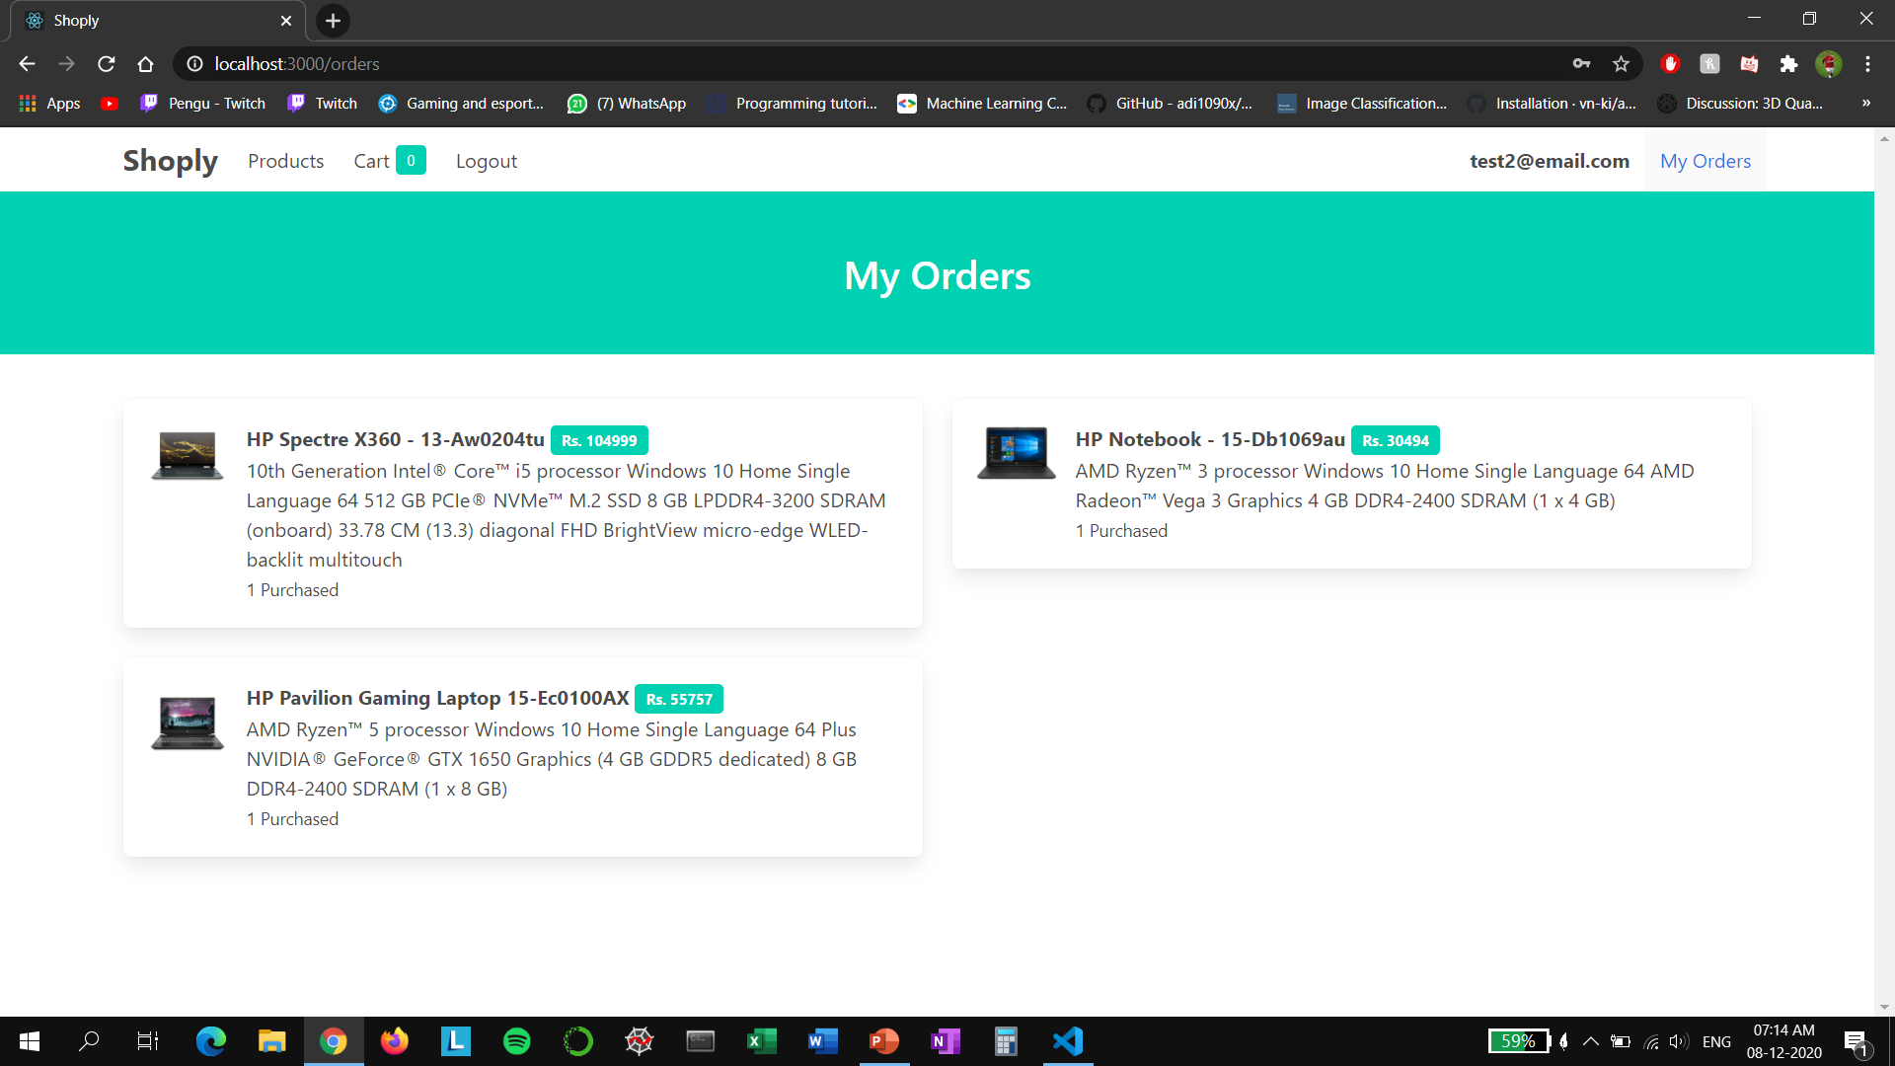
Screenshots

